Slide 1
QA Journey
The path to drive quality beyond

Slide 2

What is the QA Journey?
Is a visual representation of the different paths of specialization that the QA Engineers can take in order to advance in their careers.

Slide 3
Visual Representation
QA Journey
Foundation
Test Management
Backend Testing
Performance Testing
Mobile Testing
Frontend Testing
Optional Paths
Security Testing
Test Runners
Design Patterns
Continuous Integration

Slide 4
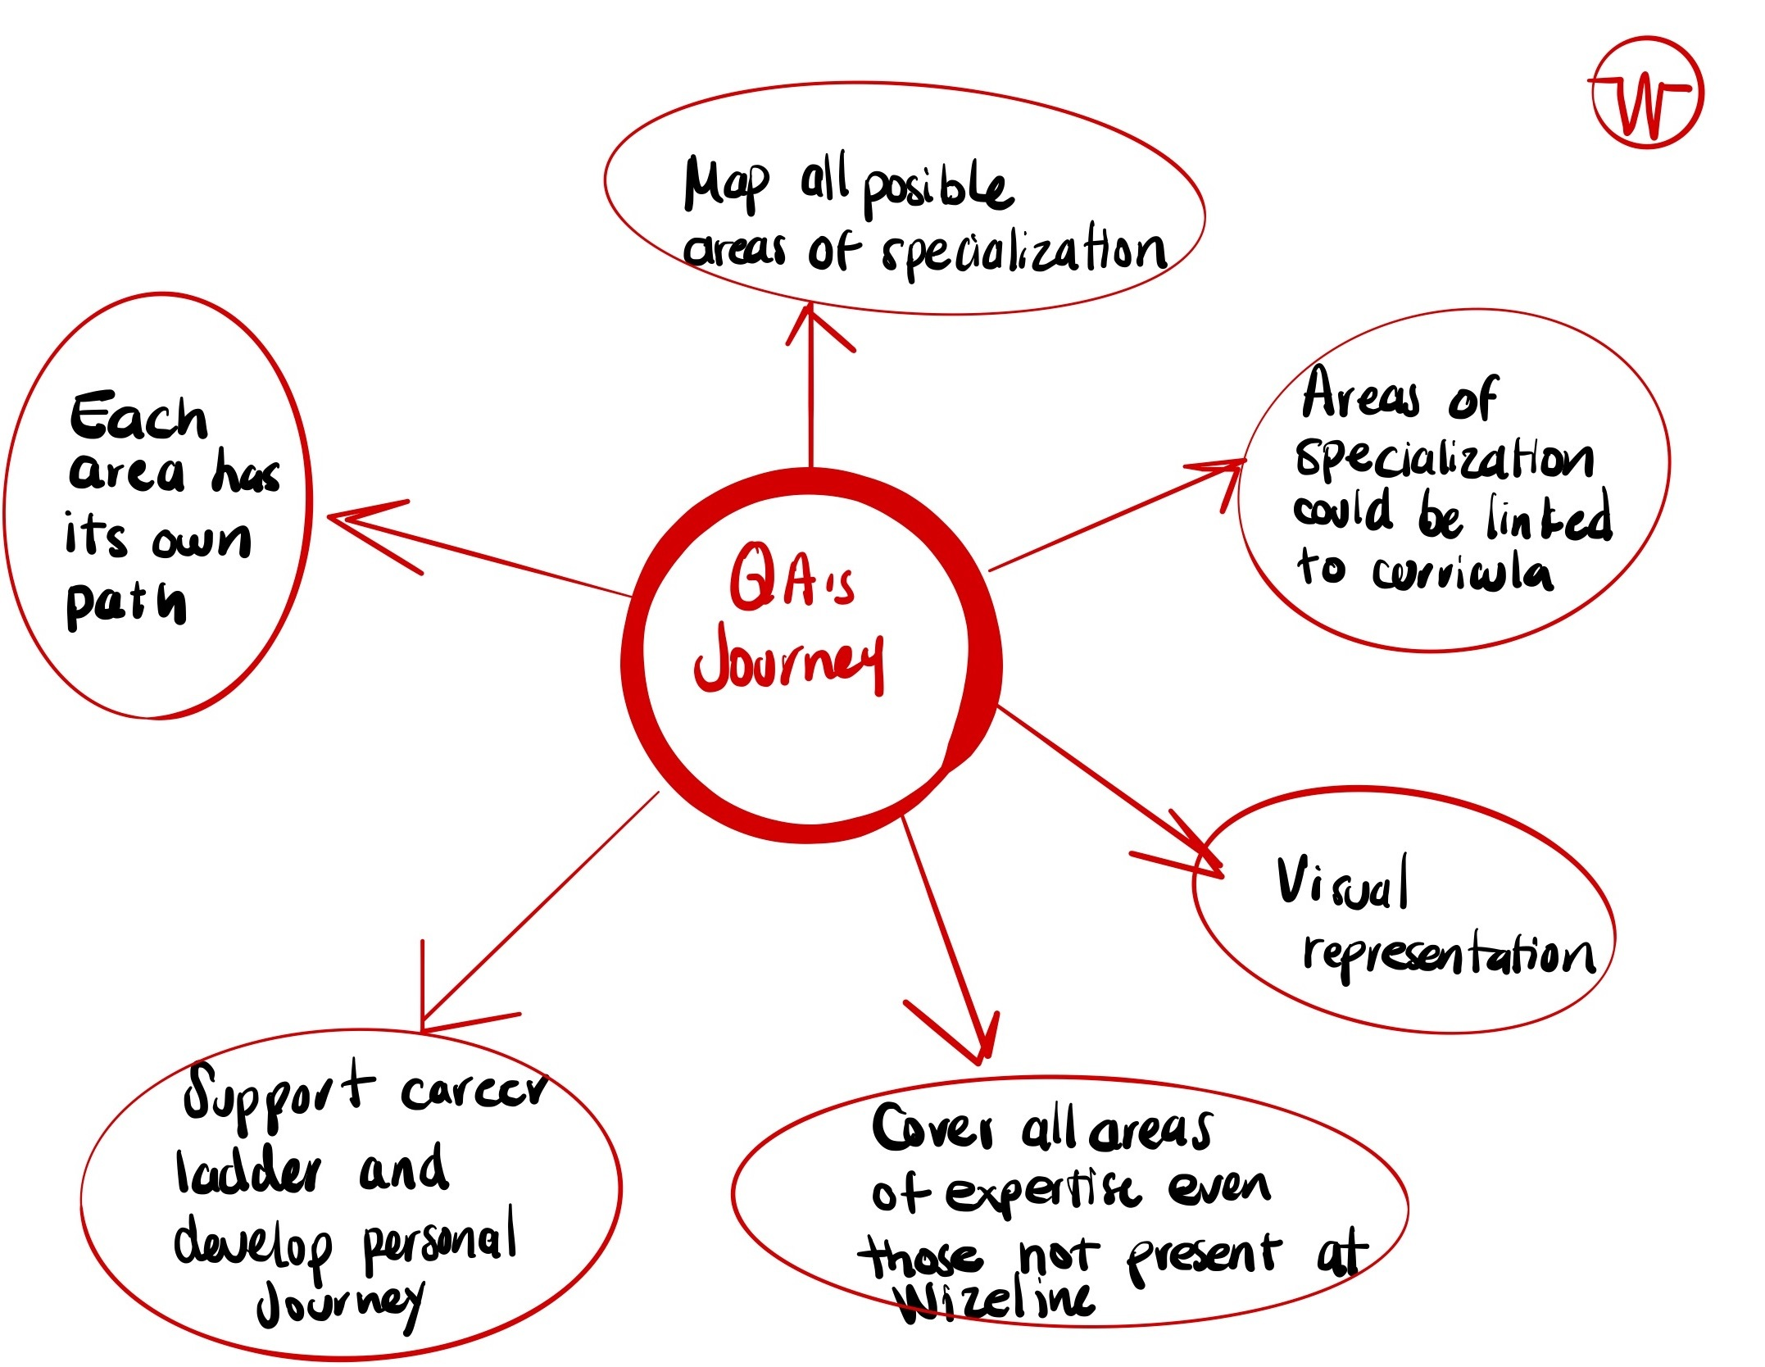
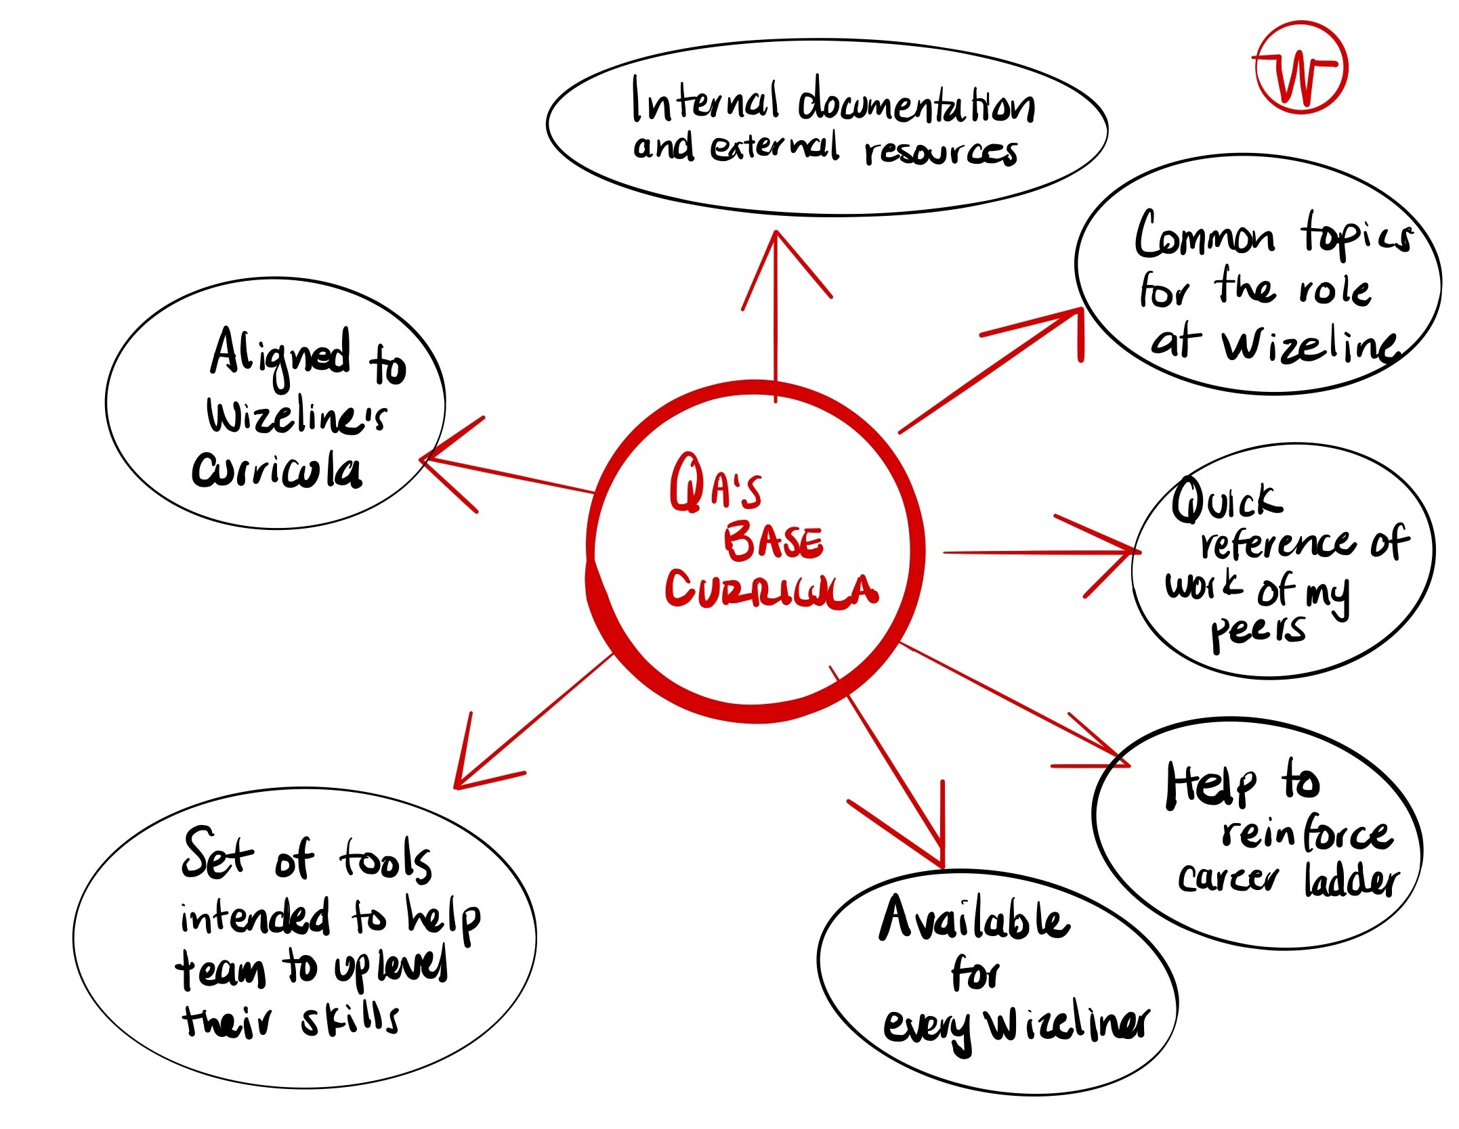
QA Journey And QA Base Curricula

Slide 5
Thank You!!

